Slide 1
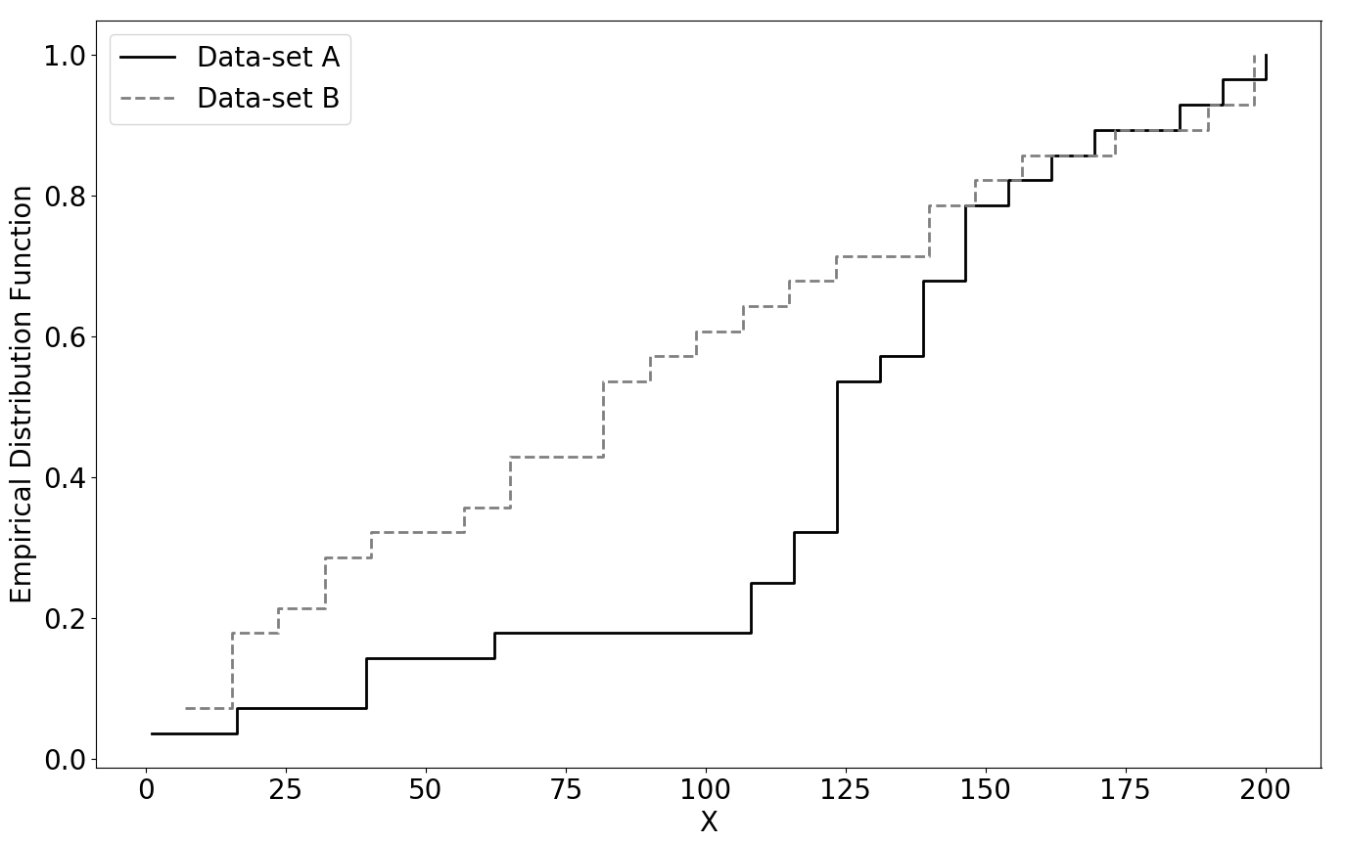
D

Slide 2
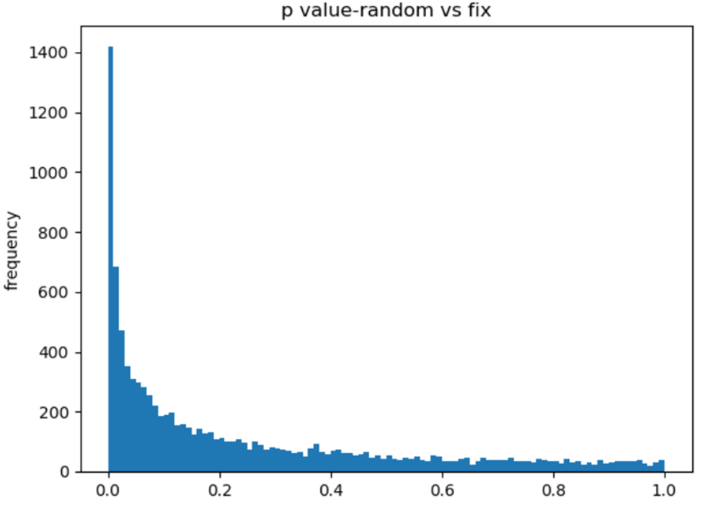
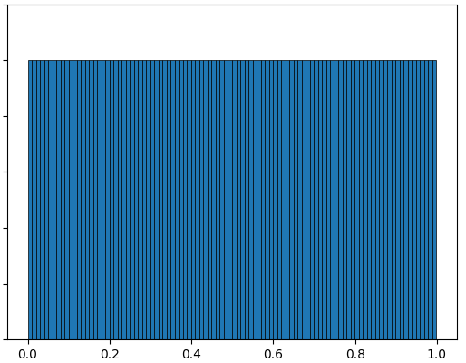



















Original
Trace-set
Bootstrap
Resample
Bootstrap
Trace-sets
Bootstrap
Estimates of
T-test p-value
$$T_{3}$$
$$T_{7}$$
$$T_{99}$$
T-test
$$p_{1}^{′}$$
$$S_{1}^{′}$$
$$T_{1}$$
$$T_{26}$$
Power
$$T_{2}$$
$$T_{1}$$
...
$$T_{n}$$
$$S_{2}^{′}$$
$$T_{49}$$
T-test
$$p_{2}^{′}$$
Distribution Constructed
Compare Distribution
(KS-test)
P-value
(KS-test)
$$S_{orig}$$
Time
…
…
$$T_{1}$$
Uniform Distribution
$$T_{2}$$
$$S_{B}^{′}$$
$$T_{96}$$
T-test
$$p_{B}^{′}$$

Slide 3
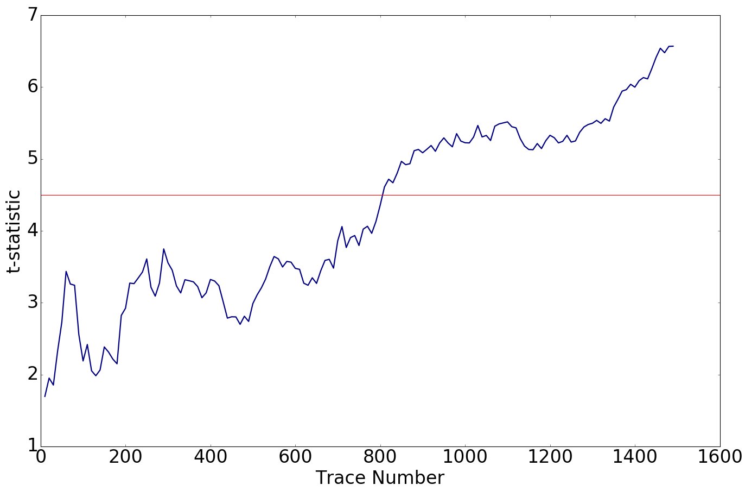
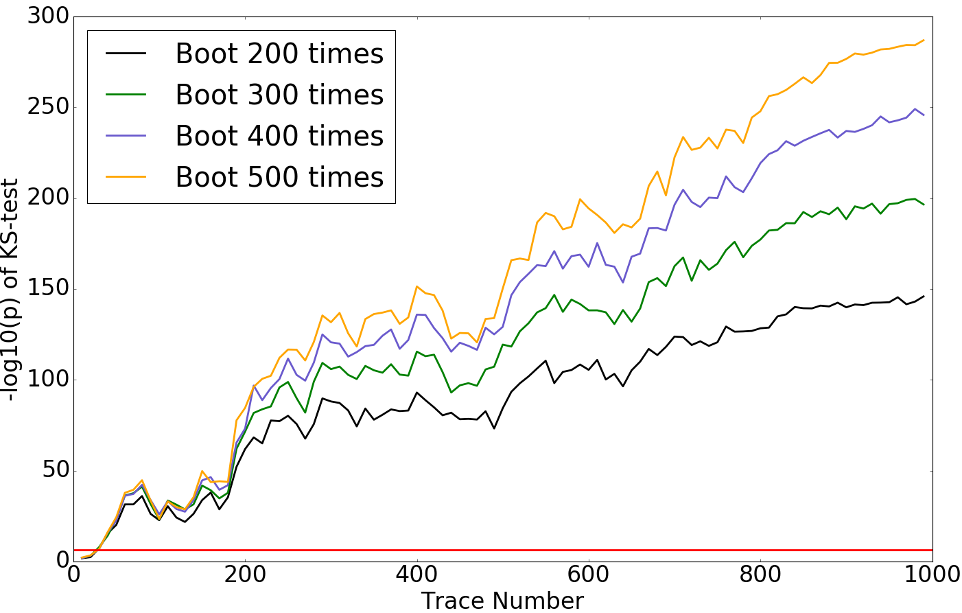
(a)
(b)

Slide 4
